Slide 1
Matrices
Gayan Perera

Slide 2
Outline
What is a matrix?
Different types of matrices
Matrix Operations
Solving a System of Linear Equations using Matrix Inversion

Slide 3
Matrices
What is a matrix?
A matrix is a rectangular array of numbers. The numbers in the array are called the entries of the matrix.
Usually, we specify a position in the matrix as row, column. The size of a matrix A is written in terms of the number of its rows x the number of its columns.
a_{ij} is called ij-entry or ij element appears in row i and column j.
We also denote the above matrix as A= [a_{ij} ]_{m x n}

Slide 4
Q
Identify the sizes of the following matrices

Slide 5
Square matrix
A square matrix is a matrix with same number of rows as columns. An n x n square matrix is said to be of order n and is sometimes called an n-square matrix
E.g.
The operations of addition, multiplication, scalar multiplication, and transpose can be performed on any n x n matrices would result in an n x n matrix.

Slide 6
Identity Matrix
The n-square identity or unit matrix, denoted by I_{n}, or simply I, is the n-square matrix with 1’s on the diagonal and 0’s elsewhere.
For any square matrix A,
Examples for identity matrices:

Slide 7
Matrix Operations
Matrix addition
Let A=[a_{ij}] and B=[b_{ij}] be two matrices with the same size, say m x n matrices. The sum of A and B, written A+B, is the matrix obtained by adding corresponding elements from A and B. That is

Slide 8
Matrix Addition
Example:

Slide 9
Matrix Operations
Scalar Multiplication
The product of the matrix A by a scalar k, written kA is the matrix obtained by multiplying each element of A by k. That is,

Slide 10
Scalar Multiplication
Example:

Slide 11
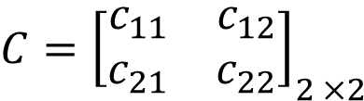
Multiplying Two Matrices
If A*B =C
Steps:
Check whether the two matrices are compatible for multiplication.
A is a 2 x 3 matrix. B is a 3 x 2 matrix.
(No. of columns of A = No. of rows of B)
Identify the dimension of the resultant matrix. (2 x 2)
$${C=\left[\begin{matrix}c_{11} & c_{12} \\ c_{21} & c_{22}\end{matrix}\right]}_{2 ×2}$$

Slide 12
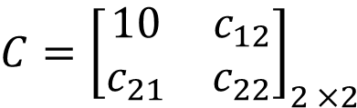
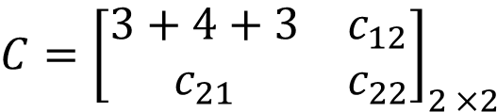

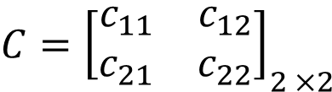
Example: Multiplying Two Matrices
If A*B =C
Steps:
3. $c_{ij}=$ dot product between i^{th} row of A and j^{th} column of B.
$${C=\left[\begin{matrix}c_{11} & c_{12} \\ c_{21} & c_{22}\end{matrix}\right]}_{2 ×2}$$
$${C=\left[\begin{matrix}3+4+3 & c_{12} \\ c_{21} & c_{22}\end{matrix}\right]}_{2 ×2}$$
$${C=\left[\begin{matrix}10 & c_{12} \\ c_{21} & c_{22}\end{matrix}\right]}_{2 ×2}$$

Slide 13
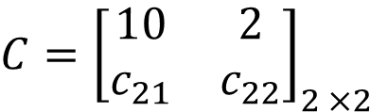
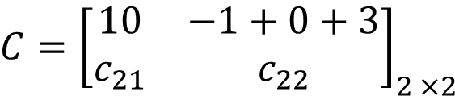
Example: Multiplying Two Matrices
If A*B =C
Steps:
3. $c_{ij}=$ dot product between i^{th} row of A and j^{th} column of B.
$${C=\left[\begin{matrix}c_{11} & c_{12} \\ c_{21} & c_{22}\end{matrix}\right]}_{2 ×2}$$
$${C=\left[\begin{matrix}10 & −1+0+3 \\ c_{21} & c_{22}\end{matrix}\right]}_{2 ×2}$$
$${C=\left[\begin{matrix}10 & 2 \\ c_{21} & c_{22}\end{matrix}\right]}_{2 ×2}$$

Slide 14
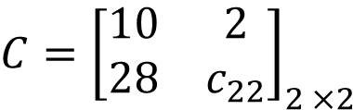
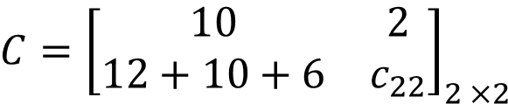
Example: Multiplying Two Matrices
If A*B =C
Steps:
3. $c_{ij}=$ dot product between i^{th} row of A and j^{th} column of B.
$${C=\left[\begin{matrix}c_{11} & c_{12} \\ c_{21} & c_{22}\end{matrix}\right]}_{2 ×2}$$
$${C=\left[\begin{matrix}10 & 2 \\ 12+10+6 & c_{22}\end{matrix}\right]}_{2 ×2}$$
$${C=\left[\begin{matrix}10 & 2 \\ 28 & c_{22}\end{matrix}\right]}_{2 ×2}$$

Slide 15
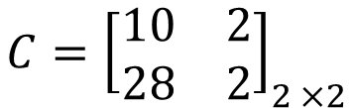
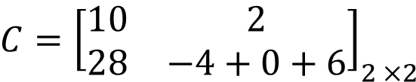
Example: Multiplying Two Matrices
If A*B =C
Steps:
3. $c_{ij}=$ dot product between i^{th} row of A and j^{th} column of B.
$${C=\left[\begin{matrix}c_{11} & c_{12} \\ c_{21} & c_{22}\end{matrix}\right]}_{2 ×2}$$
$${C=\left[\begin{matrix}10 & 2 \\ 28 & −4+0+6\end{matrix}\right]}_{2 ×2}$$
$${C=\left[\begin{matrix}10 & 2 \\ 28 & 2\end{matrix}\right]}_{2 ×2}$$

Slide 16


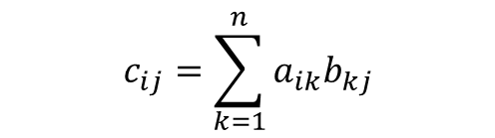
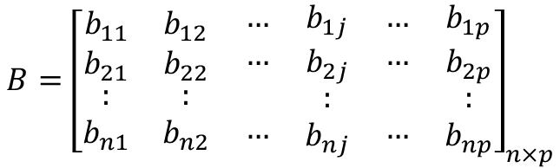
Example: Multiplying Two Matrices
If A*B =C
$$A={\left[\begin{matrix}\begin{matrix}\begin{matrix}\begin{matrix}a_{11} \\ a_{21} \\ :\end{matrix} \\ \begin{matrix}a_{i1} \\ : \\ a_{m1}\end{matrix}\end{matrix} & \begin{matrix}\begin{matrix}a_{12} \\ a_{22} \\ :\end{matrix} \\ \begin{matrix}a_{i2} \\ : \\ a_{m2}\end{matrix}\end{matrix}\end{matrix} & \begin{matrix}\begin{matrix}\begin{matrix}… \\ … \\ \end{matrix} \\ \begin{matrix}… \\ \\ …\end{matrix}\end{matrix} & \begin{matrix}\begin{matrix}a_{1n} \\ a_{2n} \\ :\end{matrix} \\ \begin{matrix}a_{in} \\ : \\ a_{mn}\end{matrix}\end{matrix}\end{matrix}\end{matrix}\right]}_{m×n}$$
$$B={\left[\begin{matrix}\begin{matrix}\begin{matrix}\begin{matrix}b_{11} \\ b_{21}\end{matrix} \\ \begin{matrix}: \\ b_{n1}\end{matrix}\end{matrix} & \begin{matrix}\begin{matrix}b_{12} \\ b_{22}\end{matrix} \\ \begin{matrix}: \\ b_{n2}\end{matrix}\end{matrix} & \begin{matrix}\begin{matrix}… \\ …\end{matrix} \\ \begin{matrix} \\ …\end{matrix}\end{matrix}\end{matrix} & \begin{matrix}\begin{matrix}\begin{matrix}b_{1j} \\ b_{2j}\end{matrix} \\ \begin{matrix}: \\ b_{nj}\end{matrix}\end{matrix} & \begin{matrix}\begin{matrix}… \\ …\end{matrix} \\ \begin{matrix} \\ …\end{matrix}\end{matrix} & \begin{matrix}\begin{matrix}b_{1p} \\ b_{2p}\end{matrix} \\ \begin{matrix}: \\ b_{np}\end{matrix}\end{matrix}\end{matrix}\end{matrix}\right]}_{n×p}$$
$$C={\left[\begin{matrix}\begin{matrix}\begin{matrix}\begin{matrix}c_{11} \\ c_{21}\end{matrix} \\ \begin{matrix}:_{} \\ c_{m1}\end{matrix}\end{matrix} & \begin{matrix}\begin{matrix}c_{12} \\ c_{22}\end{matrix} \\ \begin{matrix}:_{} \\ c_{m2}\end{matrix}\end{matrix}\end{matrix} & \begin{matrix}\begin{matrix}\begin{matrix}… \\ …\end{matrix} \\ \begin{matrix} \\ …\end{matrix}\end{matrix} & \begin{matrix}\begin{matrix}c_{1p} \\ c_{2p}\end{matrix} \\ \begin{matrix}:_{} \\ c_{mp}\end{matrix}\end{matrix}\end{matrix}\end{matrix}\right]}_{m×p}$$
$$c_{ij}=\sum_{k=1}^{n}{a_{ik}b_{kj}}$$

Slide 17
Example: Multiply the following matrices
1.
2.
3.
4.

Slide 18
Determinant of a 2 x 2 matrix
If
the determinant |A| is given by

Slide 19
Find the Determinant of the following matrices

Slide 20

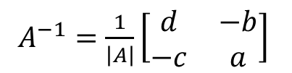


Inverse of a 2 x 2 matrix
A square matrix A is said to be invertible or nonsingular if the following relationship holds:
If
where
$$A=\left[\begin{matrix}a & b \\ c & d\end{matrix}\right]$$
$A^{−1}=\frac{1}{\left|A\right|}\left[\begin{matrix}d & −b \\ −c & a\end{matrix}\right]$
$$\left|A\right|=ad−cb$$
and $\left|A\right|≠0$

Slide 21
Solving simultaneous equations
A system of linear equations in matrix form.
e.g.
The two equations can be represented as follows:

Slide 22
Solve the following simultaneous equations
1. 2.
3. 4.

Slide 23
Minor
The minor of an element is defined as a determinant obtained by deleting the row and column containing the element. For the matrix A,
Find the following minors: M_{13,} M₂₁, M₂₂, M₂₃, M₃₁, M₃₂, M₃₃ of the matrix A.

Slide 24
Cofactor Matrix
For the given matrix A,
cofactors are obtained as follows:
C_{ij} is the elements of the cofactor matrix.

Slide 25
The cofactor matrix
Find all the cofactors .

Slide 26
Find the cofactor matrices of the following.

Slide 27
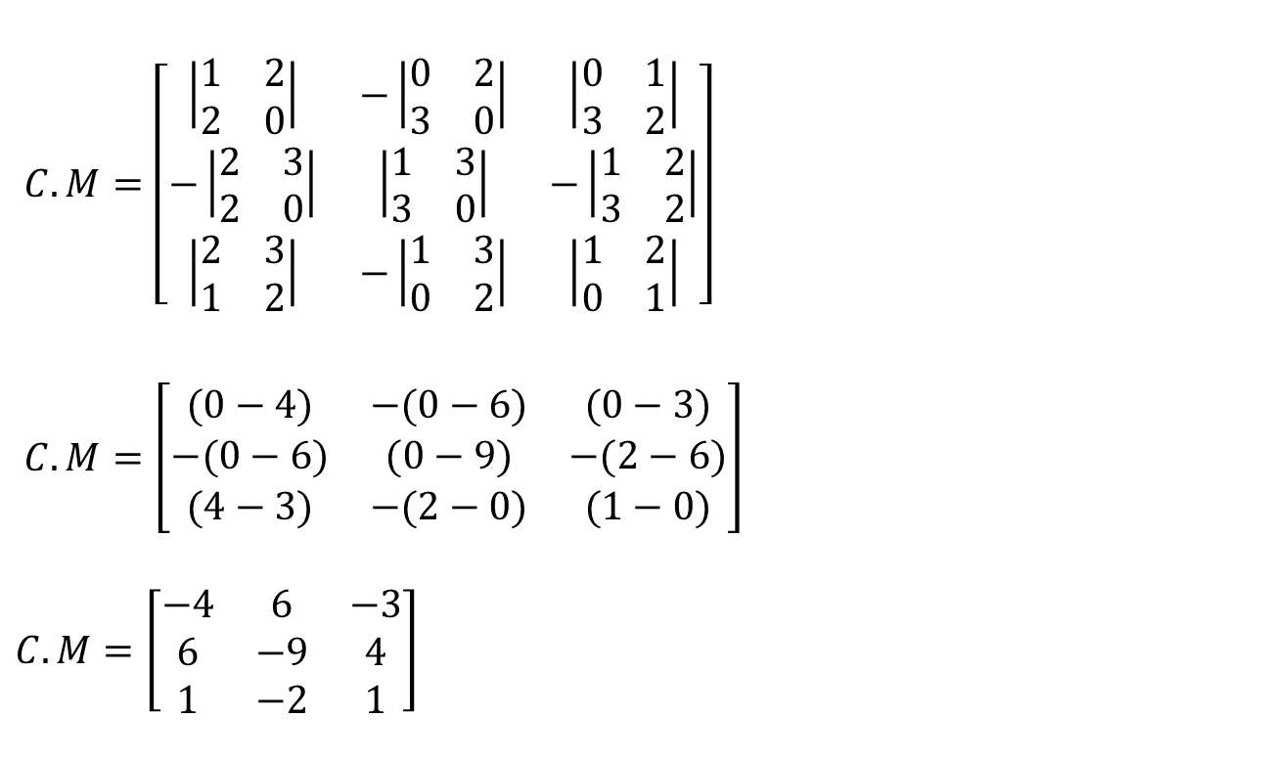

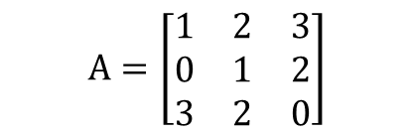
Cofactor Matrix of A
$$A=\left[\begin{matrix}1 & 2 & 3 \\ 0 & 1 & 2 \\ 3 & 2 & 0\end{matrix}\right]$$
$C.M=\left[\begin{matrix}\left|\begin{matrix}1 & 2 \\ 2 & 0\end{matrix}\right| & −\left|\begin{matrix}0 & 2 \\ 3 & 0\end{matrix}\right| & \left|\begin{matrix}0 & 1 \\ 3 & 2\end{matrix}\right| \\ −\left|\begin{matrix}2 & 3 \\ 2 & 0\end{matrix}\right| & \left|\begin{matrix}1 & 3 \\ 3 & 0\end{matrix}\right| & −\left|\begin{matrix}1 & 2 \\ 3 & 2\end{matrix}\right| \\ \left|\begin{matrix}2 & 3 \\ 1 & 2\end{matrix}\right| & −\left|\begin{matrix}1 & 3 \\ 0 & 2\end{matrix}\right| & \left|\begin{matrix}1 & 2 \\ 0 & 1\end{matrix}\right|\end{matrix}\right]$
$C.M=\left[\begin{matrix}(0−4) & −(0−6) & (0−3) \\ −(0−6) & (0−9) & −(2−6) \\ (4−3) & −(2−0) & (1−0)\end{matrix}\right]$
$$C.M=\left[\begin{matrix}−4 & 6 & −3 \\ 6 & −9 & 4 \\ 1 & −2 & 1\end{matrix}\right]$$
$$c_{ij}={(−1)}^{i+j}M_{ij}$$

Slide 28
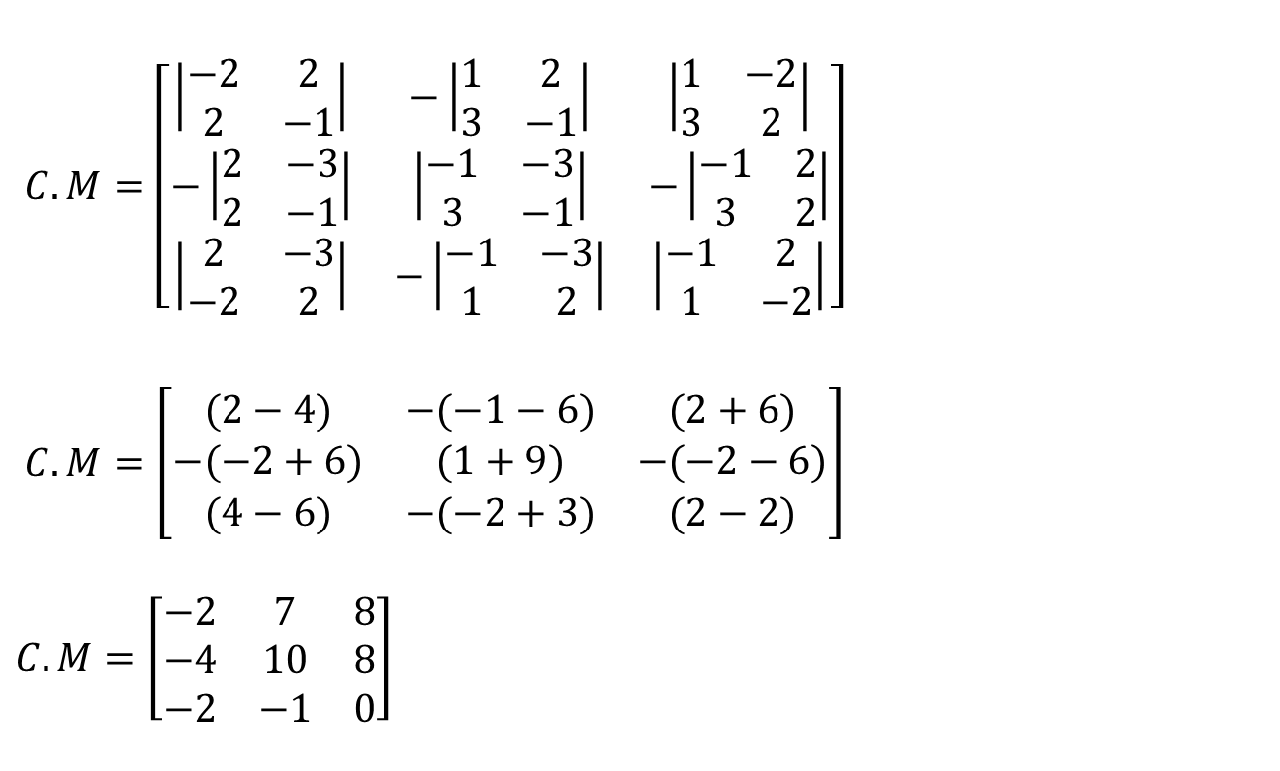

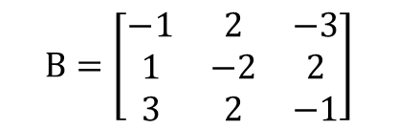
Cofactor Matrix of B
$$B=\left[\begin{matrix}−1 & 2 & −3 \\ 1 & −2 & 2 \\ 3 & 2 & −1\end{matrix}\right]$$
$C.M=\left[\begin{matrix}\left|\begin{matrix}−2 & 2 \\ 2 & −1\end{matrix}\right| & −\left|\begin{matrix}1 & 2 \\ 3 & −1\end{matrix}\right| & \left|\begin{matrix}1 & −2 \\ 3 & 2\end{matrix}\right| \\ −\left|\begin{matrix}2 & −3 \\ 2 & −1\end{matrix}\right| & \left|\begin{matrix}−1 & −3 \\ 3 & −1\end{matrix}\right| & −\left|\begin{matrix}−1 & 2 \\ 3 & 2\end{matrix}\right| \\ \left|\begin{matrix}2 & −3 \\ −2 & 2\end{matrix}\right| & −\left|\begin{matrix}−1 & −3 \\ 1 & 2\end{matrix}\right| & \left|\begin{matrix}−1 & 2 \\ 1 & −2\end{matrix}\right|\end{matrix}\right]$
$C.M=\left[\begin{matrix}(2−4) & −(−1−6) & (2+6) \\ −(−2+6) & (1+9) & −(−2−6) \\ (4−6) & −(−2+3) & (2−2)\end{matrix}\right]$
$$C.M=\left[\begin{matrix}−2 & 7 & 8 \\ −4 & 10 & 8 \\ −2 & −1 & 0\end{matrix}\right]$$
$$c_{ij}={(−1)}^{i+j}M_{ij}$$

Slide 29
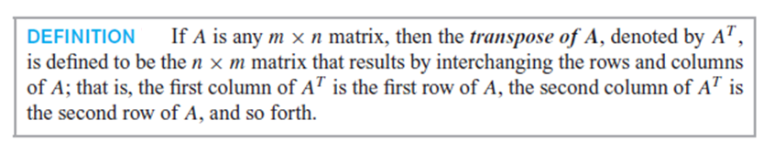
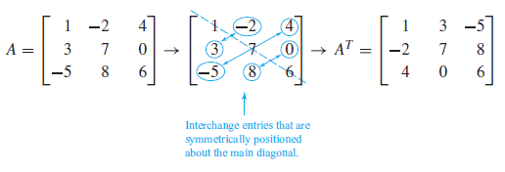
Transpose of a matrix
A transpose of a matrix is obtained by replacing all elements a_{ij} with a_{ji}. The matrix transpose, most commonly written A^{T}.

Slide 30
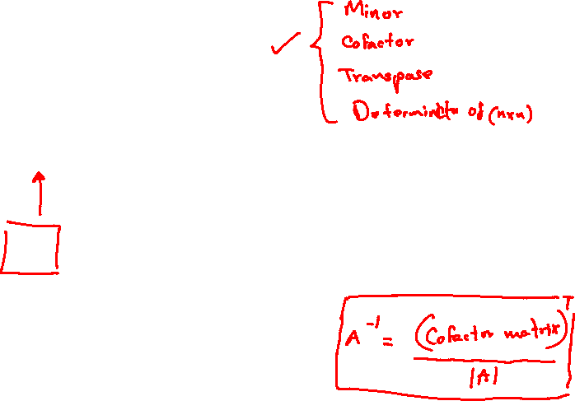
Inverse-(Adjoint Method)
If A is a n x n square matrix, its inverse is obtained by;

Slide 31
Determinant of a n x n matrix
If
the determinant |A| is given by
M_{ij} is the determinant of the matrix after deleting i^{th} row and j^{th} column

Slide 32

Determinant of a 3 x 3 matrix
If
the determinant |A| is given by
$$a_{11}M_{11}−a_{12}M_{12}+a_{13}M_{13}$$

Slide 33
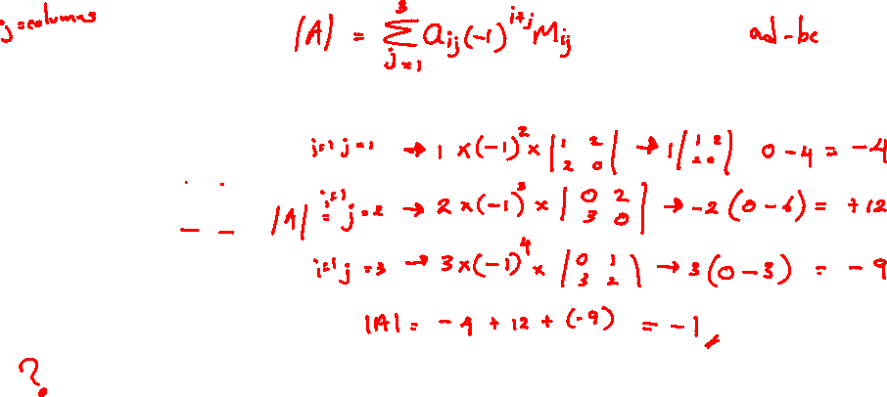
Find the Determinant of the following matrices

Slide 34

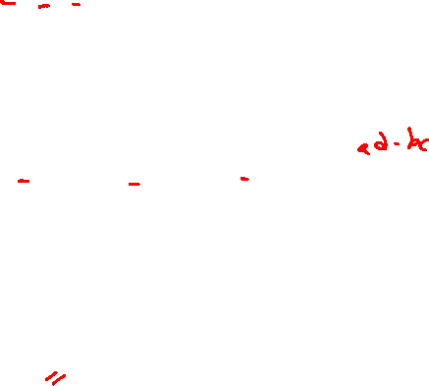
Find the Determinant of the following matrices
$A=\left[\begin{matrix}1 & 2 & 3 \\ 0 & 1 & 2 \\ 3 & 2 & 0\end{matrix}\right]$
$\left|A\right|=a_{11}M_{11}−a_{12}M_{12}+a_{13}M_{13}$
$\left|A\right|=1\left|\begin{matrix}1 & 2 \\ 2 & 0\end{matrix}\right|−2\left|\begin{matrix}0 & 2 \\ 3 & 0\end{matrix}\right|+3\left|\begin{matrix}0 & 1 \\ 3 & 2\end{matrix}\right|$
$\left|A\right|=1\left(0−4\right)−2\left(0−6\right)+3\left(0−3\right)$
$\left|A\right|=−4+12−9$
$\left|A\right|=−1$

Slide 35

Find the Determinant of the following matrices
$B=\left[\begin{matrix}−1 & 2 & −3 \\ 1 & −2 & 2 \\ 3 & 2 & −1\end{matrix}\right]$
$\left|B\right|=b_{11}M_{11}−b_{12}M_{12}+b_{13}M_{13}$
$\left|B\right|=−1\left|\begin{matrix}−2 & 2 \\ 2 & −1\end{matrix}\right|−2\left|\begin{matrix}1 & 2 \\ 3 & −1\end{matrix}\right|−3\left|\begin{matrix}1 & −2 \\ 3 & 2\end{matrix}\right|$
$\left|B\right|=−1\left(2−4\right)−2\left(−1−6\right)−3\left(2−−6\right)$
$\left|B\right|=2+14−24$
$\left|B\right|=−8$

Slide 36
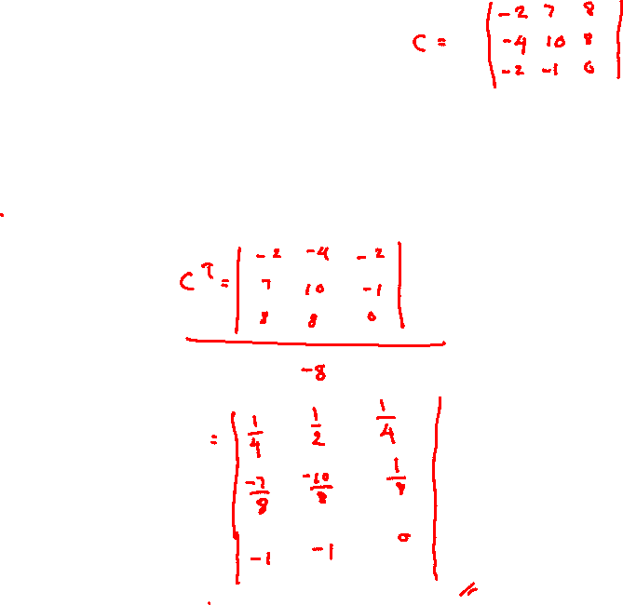
Find the inverse of the following matrices
We found the cofactor matrices and the determinants of A and B before. Now, use adjoint method to find the inverse of A and B.

Slide 37
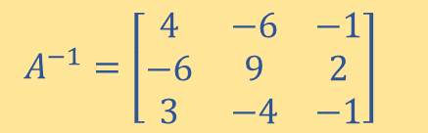


Inverse of A ($A^{−1}$)
$A=\left[\begin{matrix}1 & 2 & 3 \\ 0 & 1 & 2 \\ 3 & 2 & 0\end{matrix}\right]$ , $C.M=\left[\begin{matrix}−4 & 6 & −3 \\ 6 & −9 & 4 \\ 1 & −2 & 1\end{matrix}\right]$ , $\left|A\right|=−1$
$A^{−1}=\frac{{C M}^{T}}{\left|A\right|}$
$A^{−1}=\frac{1}{−1}\left[\begin{matrix}−4 & 6 & 1 \\ 6 & −9 & −2 \\ −3 & 4 & 1\end{matrix}\right]$ where ${C.M}^{T}=\left[\begin{matrix}−4 & 6 & 1 \\ 6 & −9 & −2 \\ −3 & 4 & 1\end{matrix}\right]$
$A^{−1}=\left[\begin{matrix}4 & −6 & −1 \\ −6 & 9 & 2 \\ 3 & −4 & −1\end{matrix}\right]$

Slide 38
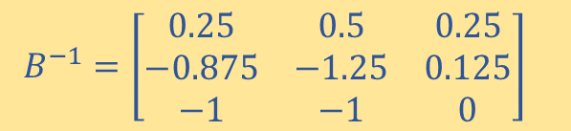


Inverse of B ($B^{−1}$)
$B=\left[\begin{matrix}−1 & 2 & −3 \\ 1 & −2 & 2 \\ 3 & 2 & −1\end{matrix}\right]$ , $C.M=\left[\begin{matrix}−2 & 7 & 8 \\ −4 & 10 & 8 \\ −2 & −1 & 0\end{matrix}\right]$, $\left|B\right|=−8$
$B^{−1}=\frac{{C M}^{T}}{\left|B\right|}$
$B^{−1}=\frac{1}{−8}\left[\begin{matrix}−2 & −4 & −2 \\ 7 & 10 & −1 \\ 8 & 8 & 0\end{matrix}\right]$ where ${C.M}^{T}=\left[\begin{matrix}−2 & −4 & −2 \\ 7 & 10 & −1 \\ 8 & 8 & 0\end{matrix}\right]$
$B^{−1}=\left[\begin{matrix}0.25 & 0.5 & 0.25 \\ −0.875 & −1.25 & 0.125 \\ −1 & −1 & 0\end{matrix}\right]$

Slide 39
System of Linear Equations
When solving a system of linear equations adjoint method is used to find the inverse of the square matrix.
Solve the following linear systems using matrix inversion.
1. 2.
3.
Notes:
1,2,3
1,-1,2

Slide 40
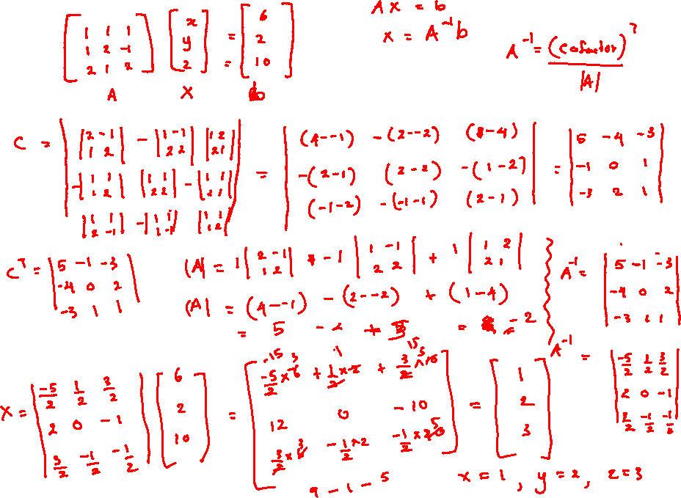

Slide 41
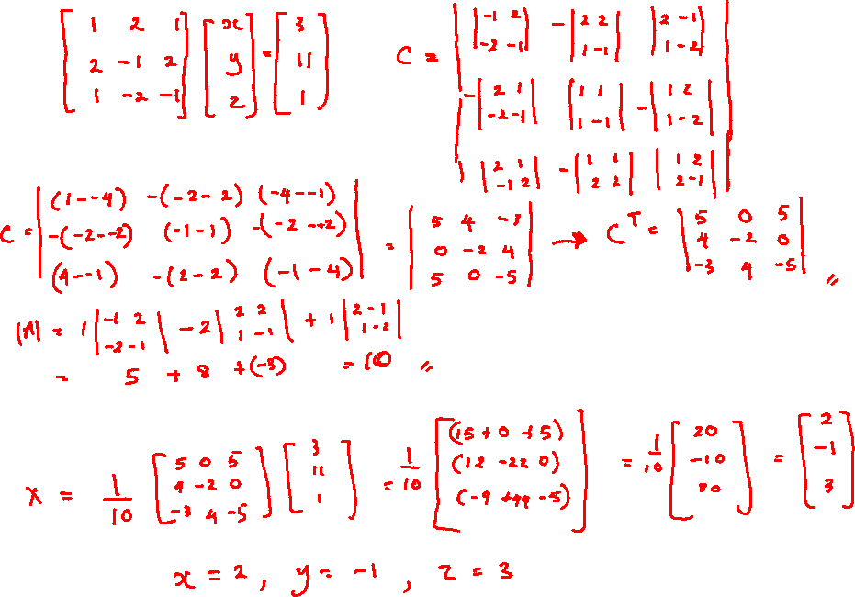
In Class Quiz 10.45 – 12.00

Slide 42
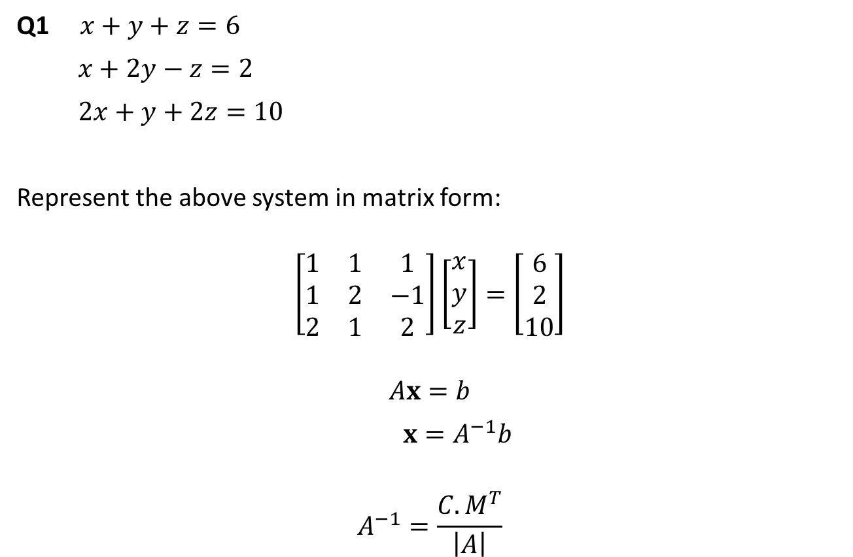
System of Linear Equations
Q1 $x+y+z=6$
$x+2y−z=2$
$2x+y+2z=10$
Represent the above system in matrix form:
$$\left[\begin{matrix}1 & 1 & 1 \\ 1 & 2 & −1 \\ 2 & 1 & 2\end{matrix}\right]\left[\begin{matrix}x \\ y \\ z\end{matrix}\right]=\left[\begin{matrix}6 \\ 2 \\ 10\end{matrix}\right]$$
$$Ax=b$$
$x=A^{−1}b$
$$A^{−1}=\frac{{C. M}^{T}}{\left|A\right|}$$

Slide 43
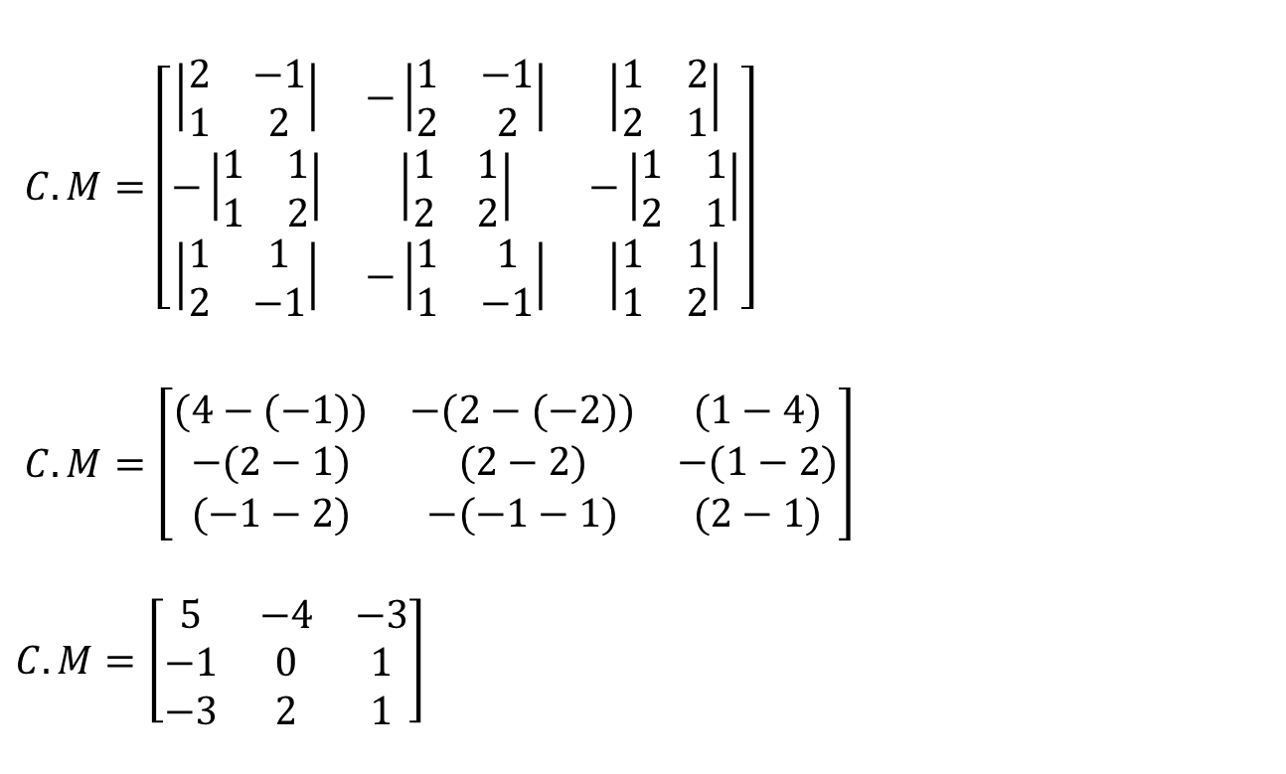

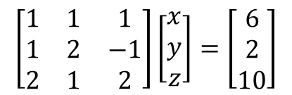
System of Linear Equations
$$\left[\begin{matrix}1 & 1 & 1 \\ 1 & 2 & −1 \\ 2 & 1 & 2\end{matrix}\right]\left[\begin{matrix}x \\ y \\ z\end{matrix}\right]=\left[\begin{matrix}6 \\ 2 \\ 10\end{matrix}\right]$$
$C.M=\left[\begin{matrix}\left|\begin{matrix}2 & −1 \\ 1 & 2\end{matrix}\right| & −\left|\begin{matrix}1 & −1 \\ 2 & 2\end{matrix}\right| & \left|\begin{matrix}1 & 2 \\ 2 & 1\end{matrix}\right| \\ −\left|\begin{matrix}1 & 1 \\ 1 & 2\end{matrix}\right| & \left|\begin{matrix}1 & 1 \\ 2 & 2\end{matrix}\right| & −\left|\begin{matrix}1 & 1 \\ 2 & 1\end{matrix}\right| \\ \left|\begin{matrix}1 & 1 \\ 2 & −1\end{matrix}\right| & −\left|\begin{matrix}1 & 1 \\ 1 & −1\end{matrix}\right| & \left|\begin{matrix}1 & 1 \\ 1 & 2\end{matrix}\right|\end{matrix}\right]$
$C.M=\left[\begin{matrix}(4−(−1)) & −(2−(−2)) & (1−4) \\ −(2−1) & (2−2) & −(1−2) \\ (−1−2) & −(−1−1) & (2−1)\end{matrix}\right]$
$$C.M=\left[\begin{matrix}5 & −4 & −3 \\ −1 & 0 & 1 \\ −3 & 2 & 1\end{matrix}\right]$$
$$c_{ij}={(−1)}^{i+j}M_{ij}$$

Slide 44

System of Linear Equations
$$\left[\begin{matrix}1 & 1 & 1 \\ 1 & 2 & −1 \\ 2 & 1 & 2\end{matrix}\right]\left[\begin{matrix}x \\ y \\ z\end{matrix}\right]=\left[\begin{matrix}6 \\ 2 \\ 10\end{matrix}\right]$$
$$C.M=\left[\begin{matrix}5 & −4 & −3 \\ −1 & 0 & 1 \\ −3 & 2 & 1\end{matrix}\right]$$
$${C.M}^{T}=\left[\begin{matrix}5 & −1 & −3 \\ −4 & 0 & 2 \\ −3 & 1 & 1\end{matrix}\right]$$
$A=\left[\begin{matrix}1 & 1 & 1 \\ 1 & 2 & −1 \\ 2 & 1 & 2\end{matrix}\right]$ $\left|A\right|=a_{11}M_{11}−a_{12}M_{12}+a_{13}M_{13}$
$\left|A\right|=1\left|\begin{matrix}2 & −1 \\ 1 & 2\end{matrix}\right|−1\left|\begin{matrix}1 & −1 \\ 2 & 2\end{matrix}\right|+1\left|\begin{matrix}1 & 2 \\ 2 & 1\end{matrix}\right|$
$\left|A\right|=\left(4+1\right)−1\left(2+2\right)+\left(1−4\right)$
$\left|A\right|=−2$

Slide 45


System of Linear Equations
$$\left[\begin{matrix}1 & 1 & 1 \\ 1 & 2 & −1 \\ 2 & 1 & 2\end{matrix}\right]\left[\begin{matrix}x \\ y \\ z\end{matrix}\right]=\left[\begin{matrix}6 \\ 2 \\ 10\end{matrix}\right]$$
$$A^{−1}=\frac{{C. M}^{T}}{\left|A\right|}$$
$$A^{−1}=\frac{1}{−2}\left[\begin{matrix}5 & −1 & −3 \\ −4 & 0 & 2 \\ −3 & 1 & 1\end{matrix}\right]$$
$x=A^{−1}b$
$$x=\frac{1}{−2}\left[\begin{matrix}5 & −1 & −3 \\ −4 & 0 & 2 \\ −3 & 1 & 1\end{matrix}\right]\left[\begin{matrix}6 \\ 2 \\ 10\end{matrix}\right]=\frac{1}{−2}\left[\begin{matrix}30−2−30 \\ −24+0+20 \\ −18+2+10\end{matrix}\right]$$
$$=\frac{1}{−2}\left[\begin{matrix}−2 \\ −4 \\ −6\end{matrix}\right]=\left[\begin{matrix}1 \\ 2 \\ 3\end{matrix}\right]$$
$$x=1$$
$$y=2$$
$$z=3$$

Slide 46
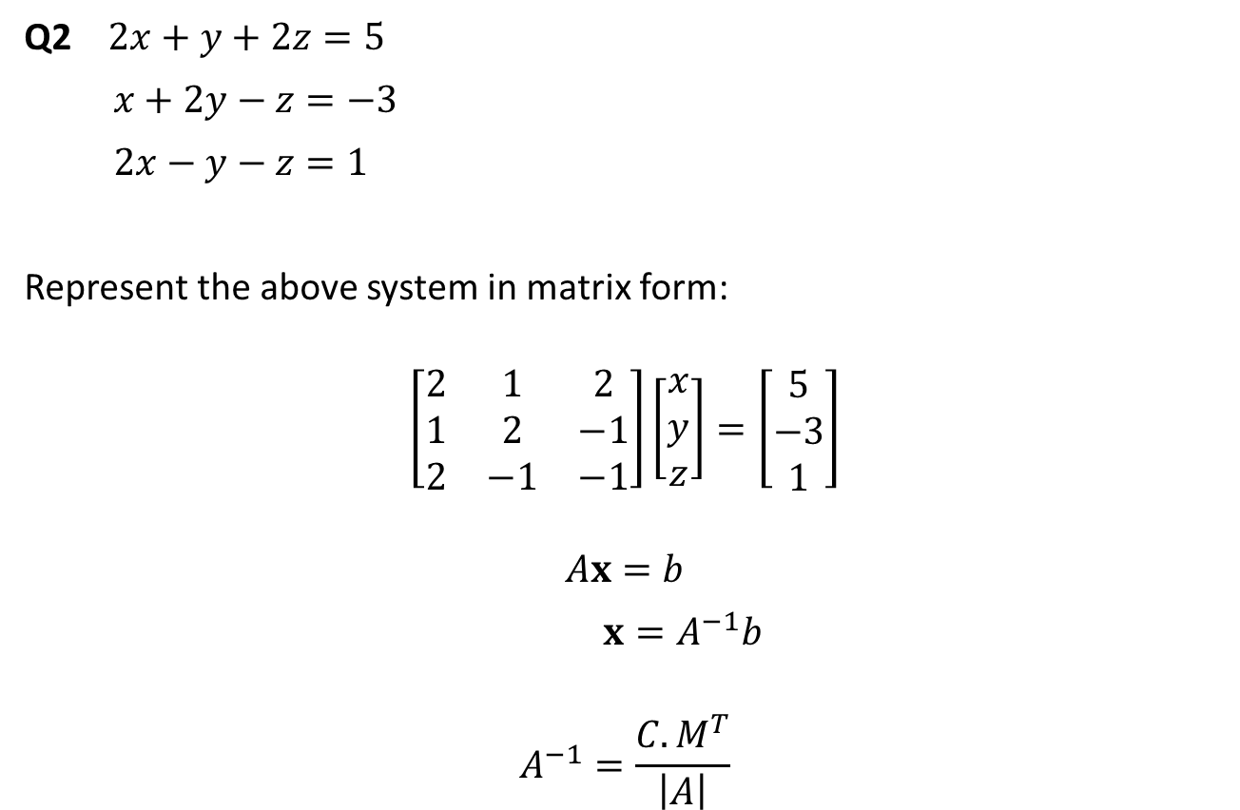
System of Linear Equations
Q2 $2x+y+2z=5$
$x+2y−z=−3$
$2x−y−z=1$
Represent the above system in matrix form:
$$\left[\begin{matrix}2 & 1 & 2 \\ 1 & 2 & −1 \\ 2 & −1 & −1\end{matrix}\right]\left[\begin{matrix}x \\ y \\ z\end{matrix}\right]=\left[\begin{matrix}5 \\ −3 \\ 1\end{matrix}\right]$$
$$Ax=b$$
$x=A^{−1}b$
$$A^{−1}=\frac{{C. M}^{T}}{\left|A\right|}$$

Slide 47
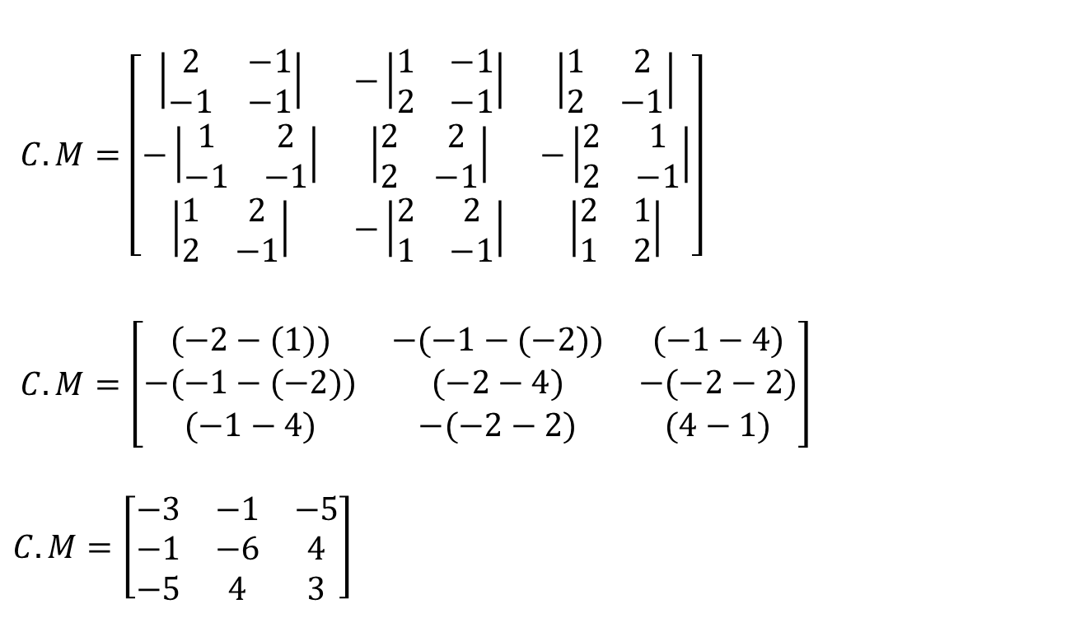

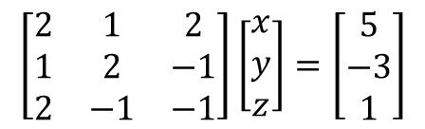
System of Linear Equations
$$\left[\begin{matrix}2 & 1 & 2 \\ 1 & 2 & −1 \\ 2 & −1 & −1\end{matrix}\right]\left[\begin{matrix}x \\ y \\ z\end{matrix}\right]=\left[\begin{matrix}5 \\ −3 \\ 1\end{matrix}\right]$$
$C.M=\left[\begin{matrix}\left|\begin{matrix}2 & −1 \\ −1 & −1\end{matrix}\right| & −\left|\begin{matrix}1 & −1 \\ 2 & −1\end{matrix}\right| & \left|\begin{matrix}1 & 2 \\ 2 & −1\end{matrix}\right| \\ −\left|\begin{matrix}1 & 2 \\ −1 & −1\end{matrix}\right| & \left|\begin{matrix}2 & 2 \\ 2 & −1\end{matrix}\right| & −\left|\begin{matrix}2 & 1 \\ 2 & −1\end{matrix}\right| \\ \left|\begin{matrix}1 & 2 \\ 2 & −1\end{matrix}\right| & −\left|\begin{matrix}2 & 2 \\ 1 & −1\end{matrix}\right| & \left|\begin{matrix}2 & 1 \\ 1 & 2\end{matrix}\right|\end{matrix}\right]$
$C.M=\left[\begin{matrix}(−2−(1)) & −(−1−(−2)) & (−1−4) \\ −(−1−(−2)) & (−2−4) & −(−2−2) \\ (−1−4) & −(−2−2) & (4−1)\end{matrix}\right]$
$$C.M=\left[\begin{matrix}−3 & −1 & −5 \\ −1 & −6 & 4 \\ −5 & 4 & 3\end{matrix}\right]$$
$$c_{ij}={(−1)}^{i+j}M_{ij}$$

Slide 48
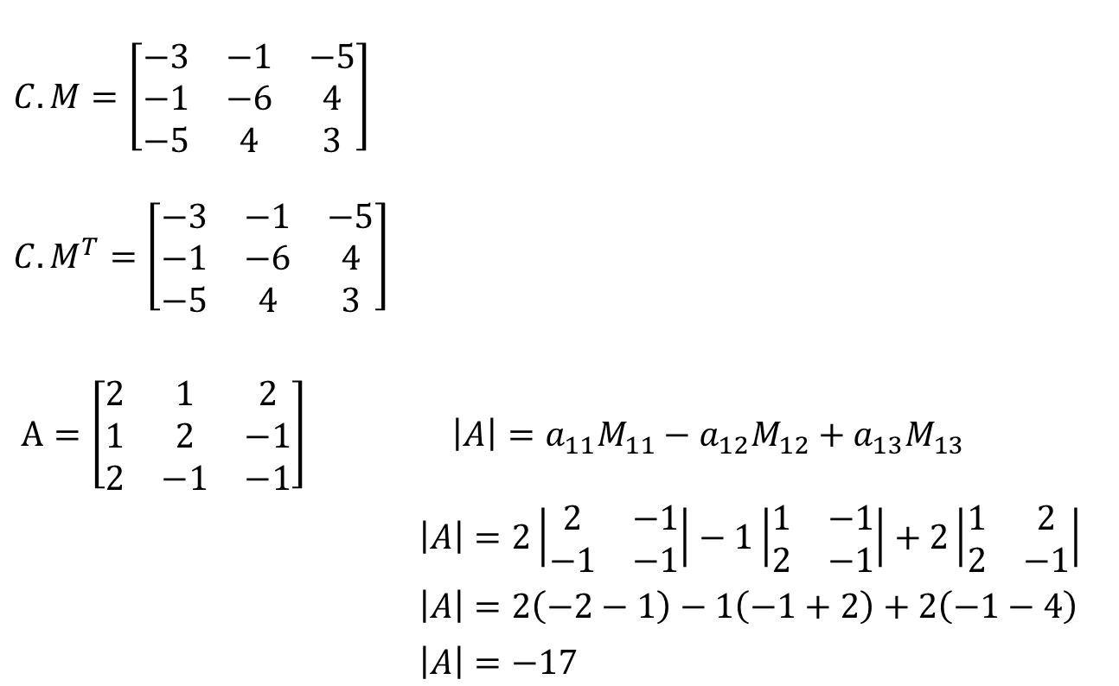
System of Linear Equations
$$\left[\begin{matrix}2 & 1 & 2 \\ 1 & 2 & −1 \\ 2 & −1 & −1\end{matrix}\right]\left[\begin{matrix}x \\ y \\ z\end{matrix}\right]=\left[\begin{matrix}5 \\ −3 \\ 1\end{matrix}\right]$$
$$C.M=\left[\begin{matrix}−3 & −1 & −5 \\ −1 & −6 & 4 \\ −5 & 4 & 3\end{matrix}\right]$$
$${C.M}^{T}=\left[\begin{matrix}−3 & −1 & −5 \\ −1 & −6 & 4 \\ −5 & 4 & 3\end{matrix}\right]$$
$A=\left[\begin{matrix}2 & 1 & 2 \\ 1 & 2 & −1 \\ 2 & −1 & −1\end{matrix}\right]$ $\left|A\right|=a_{11}M_{11}−a_{12}M_{12}+a_{13}M_{13}$
$\left|A\right|=2\left|\begin{matrix}2 & −1 \\ −1 & −1\end{matrix}\right|−1\left|\begin{matrix}1 & −1 \\ 2 & −1\end{matrix}\right|+2\left|\begin{matrix}1 & 2 \\ 2 & −1\end{matrix}\right|$
$\left|A\right|=2\left(−2−1\right)−1\left(−1+2\right)+2\left(−1−4\right)$
$\left|A\right|=−17$

Slide 49


System of Linear Equations
$$\left[\begin{matrix}2 & 1 & 2 \\ 1 & 2 & −1 \\ 2 & −1 & −1\end{matrix}\right]\left[\begin{matrix}x \\ y \\ z\end{matrix}\right]=\left[\begin{matrix}5 \\ −3 \\ 1\end{matrix}\right]$$
$$A^{−1}=\frac{{C. M}^{T}}{\left|A\right|}$$
$$A^{−1}=\frac{1}{−17}\left[\begin{matrix}−3 & −1 & −5 \\ −1 & −6 & 4 \\ −5 & 4 & 3\end{matrix}\right]$$
$x=A^{−1}b$
$$x=\frac{1}{−17}\left[\begin{matrix}−3 & −1 & −5 \\ −1 & −6 & 4 \\ −5 & 4 & 3\end{matrix}\right]\left[\begin{matrix}5 \\ −3 \\ 1\end{matrix}\right]=\frac{1}{−17}\left[\begin{matrix}−15+3−5 \\ −5+18+4 \\ −25−12+3\end{matrix}\right]$$
$$=\frac{1}{−17}\left[\begin{matrix}−17 \\ 17 \\ −34\end{matrix}\right]=\left[\begin{matrix}1 \\ −1 \\ 2\end{matrix}\right]$$
$$x=1$$
$$y=−1$$
$$z=2$$

Slide 50
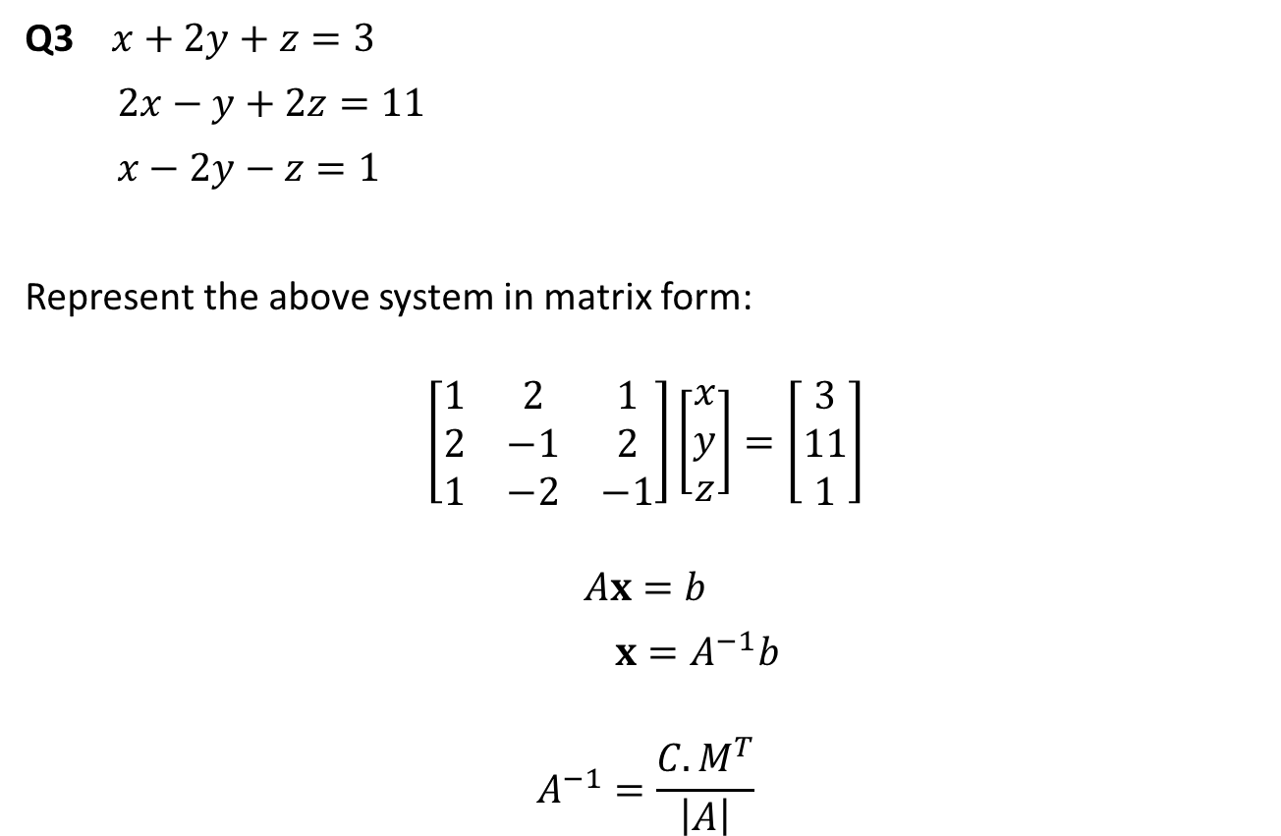
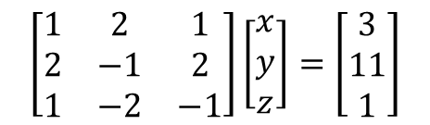
System of Linear Equations
$$\left[\begin{matrix}1 & 2 & 1 \\ 2 & −1 & 2 \\ 1 & −2 & −1\end{matrix}\right]\left[\begin{matrix}x \\ y \\ z\end{matrix}\right]=\left[\begin{matrix}3 \\ 11 \\ 1\end{matrix}\right]$$
Q3 $x+2y+z=3$
$2x−y+2z=11$
$x−2y−z=1$
Represent the above system in matrix form:
$$\left[\begin{matrix}1 & 2 & 1 \\ 2 & −1 & 2 \\ 1 & −2 & −1\end{matrix}\right]\left[\begin{matrix}x \\ y \\ z\end{matrix}\right]=\left[\begin{matrix}3 \\ 11 \\ 1\end{matrix}\right]$$
$$Ax=b$$
$x=A^{−1}b$
$$A^{−1}=\frac{{C. M}^{T}}{\left|A\right|}$$

Slide 51
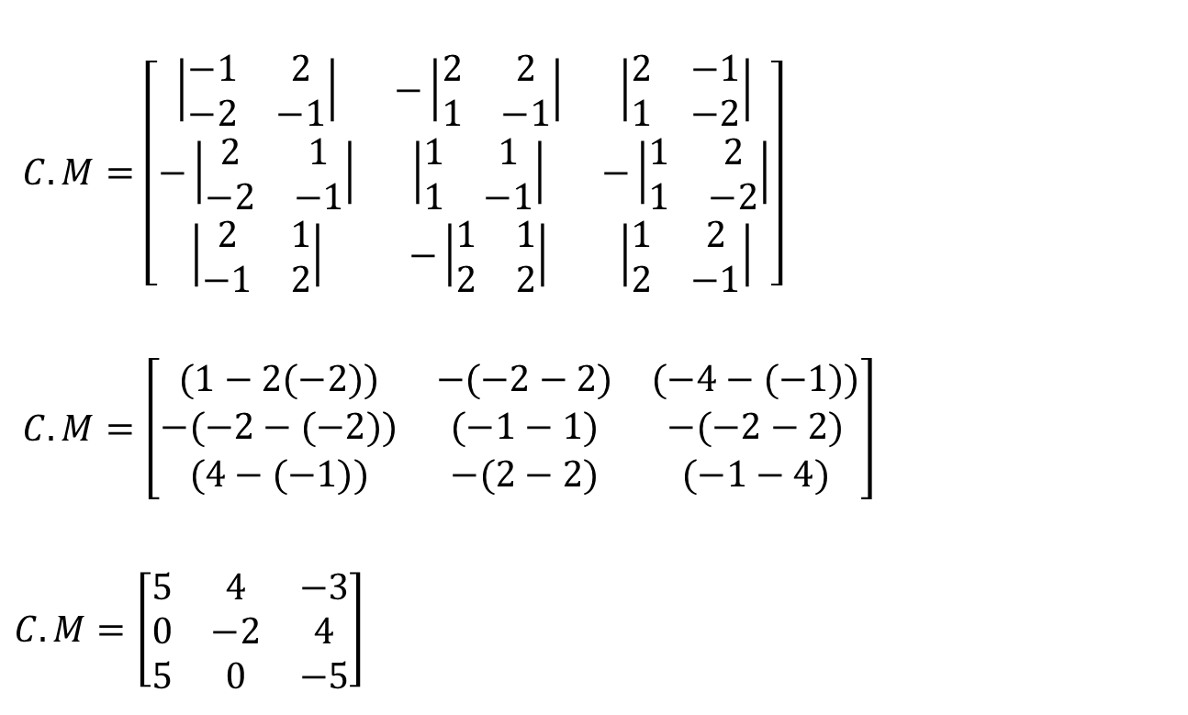
System of Linear Equations
$$\left[\begin{matrix}1 & 2 & 1 \\ 2 & −1 & 2 \\ 1 & −2 & −1\end{matrix}\right]\left[\begin{matrix}x \\ y \\ z\end{matrix}\right]=\left[\begin{matrix}3 \\ 11 \\ 1\end{matrix}\right]$$
$C.M=\left[\begin{matrix}\left|\begin{matrix}−1 & 2 \\ −2 & −1\end{matrix}\right| & −\left|\begin{matrix}2 & 2 \\ 1 & −1\end{matrix}\right| & \left|\begin{matrix}2 & −1 \\ 1 & −2\end{matrix}\right| \\ −\left|\begin{matrix}2 & 1 \\ −2 & −1\end{matrix}\right| & \left|\begin{matrix}1 & 1 \\ 1 & −1\end{matrix}\right| & −\left|\begin{matrix}1 & 2 \\ 1 & −2\end{matrix}\right| \\ \left|\begin{matrix}2 & 1 \\ −1 & 2\end{matrix}\right| & −\left|\begin{matrix}1 & 1 \\ 2 & 2\end{matrix}\right| & \left|\begin{matrix}1 & 2 \\ 2 & −1\end{matrix}\right|\end{matrix}\right]$
$C.M=\left[\begin{matrix}(1−2(−2)) & −(−2−2) & (−4−(−1)) \\ −(−2−(−2)) & (−1−1) & −(−2−2) \\ (4−(−1)) & −(2−2) & (−1−4)\end{matrix}\right]$
$C.M=\left[\begin{matrix}5 & 4 & −3 \\ 0 & −2 & 4 \\ 5 & 0 & −5\end{matrix}\right]$
$$c_{ij}={(−1)}^{i+j}M_{ij}$$

Slide 52

System of Linear Equations
$$\left[\begin{matrix}1 & 2 & 1 \\ 2 & −1 & 2 \\ 1 & −2 & −1\end{matrix}\right]\left[\begin{matrix}x \\ y \\ z\end{matrix}\right]=\left[\begin{matrix}3 \\ 11 \\ 1\end{matrix}\right]$$
$$C.M=\left[\begin{matrix}5 & 4 & −3 \\ 0 & −2 & 4 \\ 5 & 0 & −5\end{matrix}\right]$$
$${C.M}^{T}=\left[\begin{matrix}5 & 0 & 5 \\ 4 & −2 & 0 \\ −3 & 4 & −5\end{matrix}\right]$$
$A=\left[\begin{matrix}1 & 2 & 1 \\ 2 & −1 & 2 \\ 1 & −2 & −1\end{matrix}\right]$ $\left|A\right|=a_{11}M_{11}−a_{12}M_{12}+a_{13}M_{13}$
$\left|A\right|=1\left|\begin{matrix}−1 & 2 \\ −2 & −1\end{matrix}\right|−2\left|\begin{matrix}2 & 2 \\ 1 & −1\end{matrix}\right|+1\left|\begin{matrix}2 & −1 \\ 1 & −2\end{matrix}\right|$
$\left|A\right|=1\left(1+4\right)−2\left(−2−2\right)+1\left(−4+1\right)$
$\left|A\right|=10$

Slide 53


System of Linear Equations
$$\left[\begin{matrix}1 & 2 & 1 \\ 2 & −1 & 2 \\ 1 & −2 & −1\end{matrix}\right]\left[\begin{matrix}x \\ y \\ z\end{matrix}\right]=\left[\begin{matrix}3 \\ 11 \\ 1\end{matrix}\right]$$
$$A^{−1}=\frac{{C. M}^{T}}{\left|A\right|}$$
$$A^{−1}=\frac{1}{10}\left[\begin{matrix}5 & 0 & 5 \\ 4 & −2 & 0 \\ −3 & 4 & −5\end{matrix}\right]$$
$x=A^{−1}b$
$$x=\frac{1}{10}\left[\begin{matrix}5 & 0 & 5 \\ 4 & −2 & 0 \\ −3 & 4 & −5\end{matrix}\right]\left[\begin{matrix}3 \\ 11 \\ 1\end{matrix}\right]=\frac{1}{10}\left[\begin{matrix}15+0+5 \\ 12−22+0 \\ −9+44−5\end{matrix}\right]$$
$$=\frac{1}{10}\left[\begin{matrix}20 \\ −10 \\ 30\end{matrix}\right]=\left[\begin{matrix}2 \\ −1 \\ 3\end{matrix}\right]$$
$$x=2$$
$$y=−1$$
$$z=3$$

Slide 54


